Slide 1
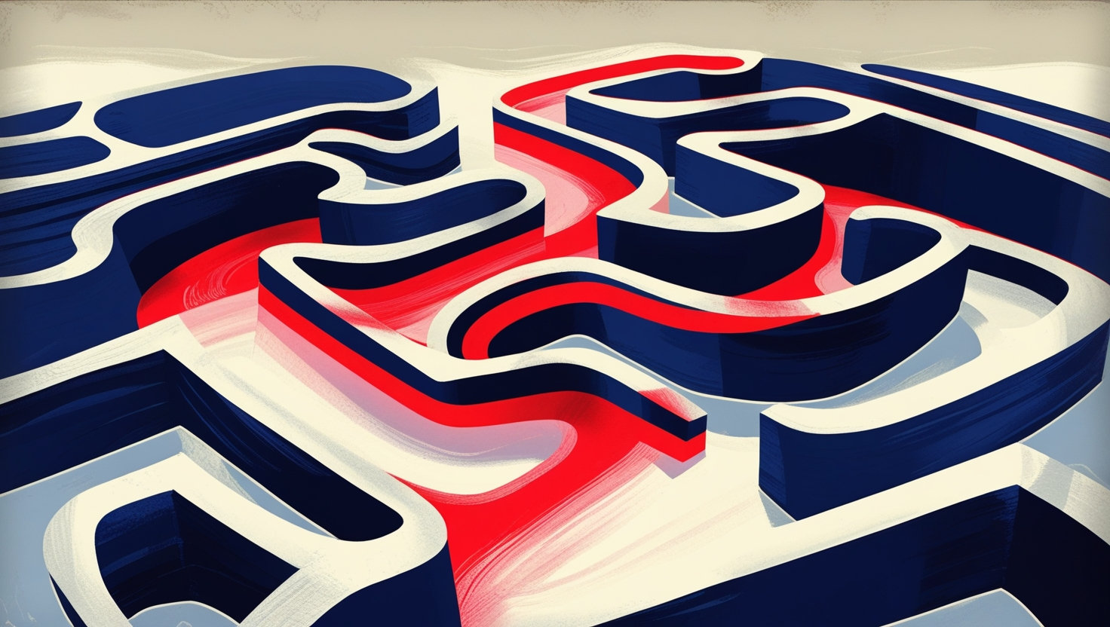
Maze Solver
Algo Avengers
20/ENG/016 – Buwaneka R.I.
20/ENG/061 – Jayasinghe M.A.R.D.
20/ENG/014 – Batangala D.R.A.M.M.K.

Slide 2
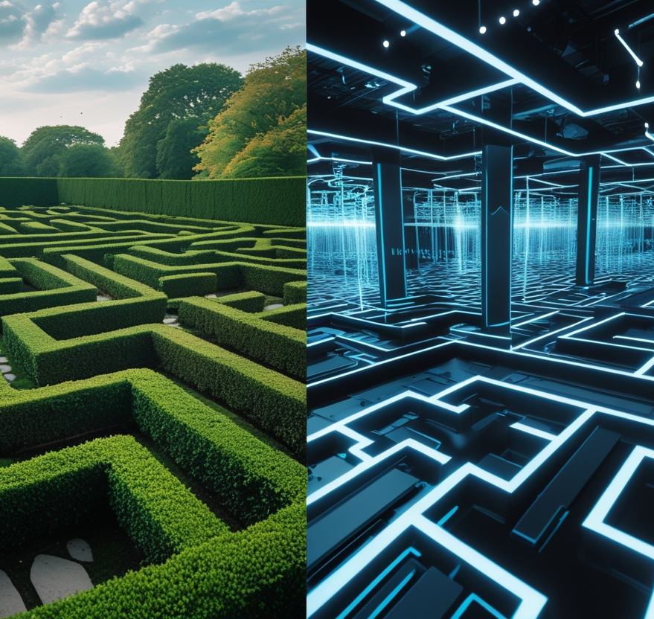
Introduction
Maze solving = Starting point to a goal without hitting any obstacles
Represent complex navigation challenges.
Robotics
Games
Maps

Slide 3

Objectives
Implement and compare maze-solving algorithms.
Provide a user-friendly interface for maze generation and solving.
Visualize the step-by-step operation of each algorithm.

Slide 4
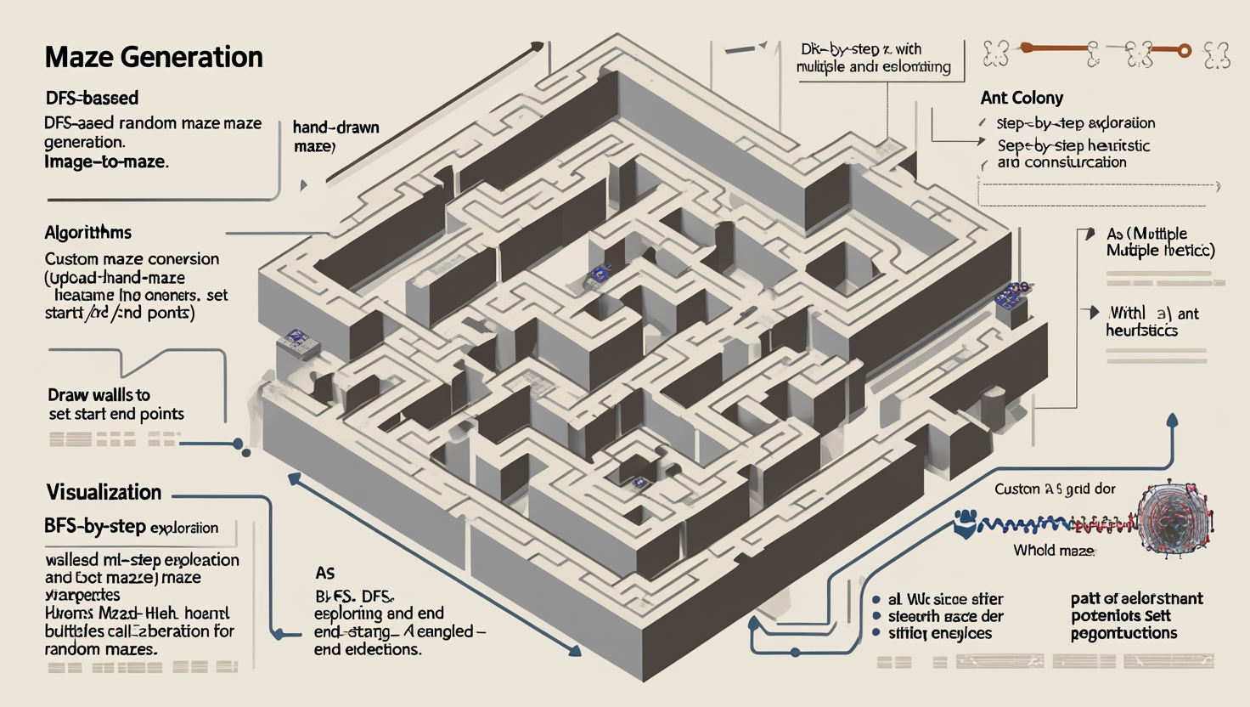
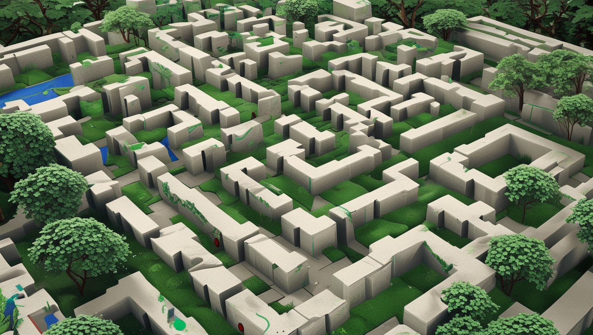
Key Features
Maze Generation
DFS-based random maze generation.
Image-to-maze conversion (upload hand-drawn mazes).
Custom maze editor (draw walls, set start/end points).
Algorithms
BFS
DFS
Dijkstra
A* (with multiple heuristics)
Ant Colony.
Visualization
Step-by-step exploration and path reconstruction.

Slide 5
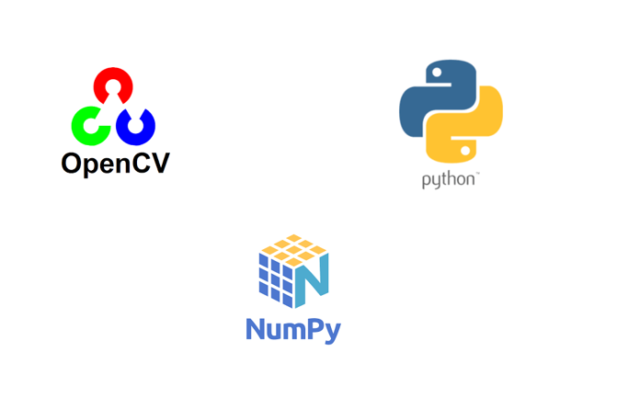

Technical Stack
Language
Python
Libraries
numpy (maze representation)
matplotlib (visualization)
OpenCV (image processing).
Streamlit (interactive web interface).
Concepts
Graph Theory
Heuristic

Slide 6
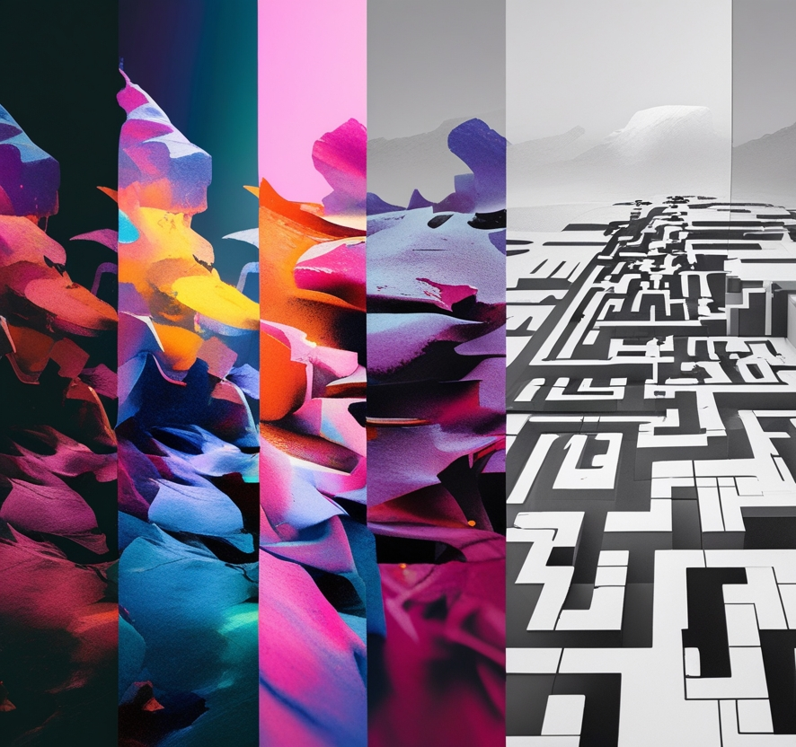
Image to Maze Conversion
Preprocessing
Convert to grayscale → Apply Gaussian blur to reduce noise.
Adaptive Thresholding: Handle lighting variations
Contour Detection
Find maze walls using cv2.findContours.
Filter small contours (noise) based on area.
Perspective Correction:
Detect maze corners → Apply homography transform to "straighten" skewed images.
Binary Conversion
Dilate/erode to fix gaps in walls.
Convert to 0s (paths) and 1s (walls) with thresholding.
Start/End Detection
Scan edges of the image for openings (white pixels on borders).

Slide 7
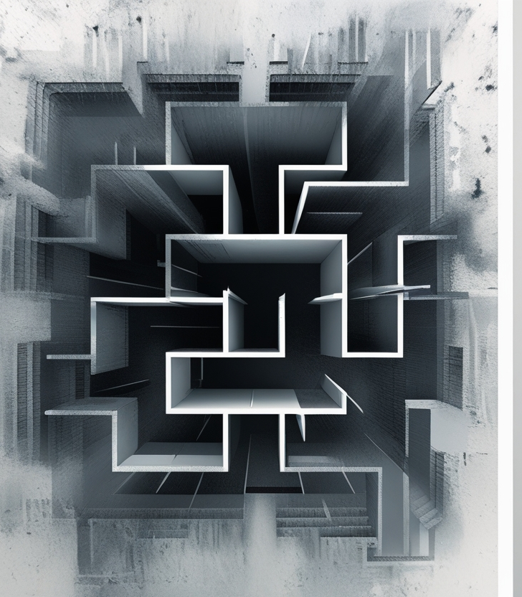
Challenges
Heavy memory utilization for large mazes.
Long time for visualization of the algorithms due to the pauses in between.
Ant Colony Optimization sometimes take many iterations for large mazes.
Converting an image to a maze due to the varying wall and path thicknesses in different mazes.

Slide 8
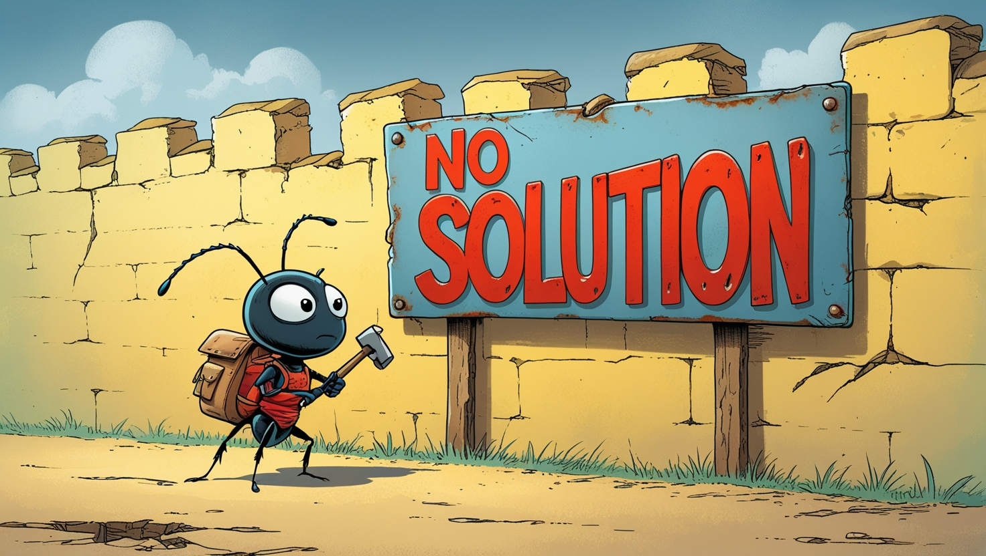
Limitations
Algorithm Limitations: Ant Colony does not always give a solution due to limited number of iterations
Maze Representation: Limited to 2D grids. 3D or dynamic mazes can't be represented.
Custom Maze Editor: Limited to small mazes due to UI constraints.

Slide 9

Future Enhancements
Expand to support 3D mazes for advanced pathfinding.
Update supporting real-time updating of the maze while the algorithm is running.
Combine different algorithms (e.g., A* with Ant Colony) for better performance.
Add more path finding algorithms.
Explore multi-agent simulations finding the maze in parallel.

Slide 10
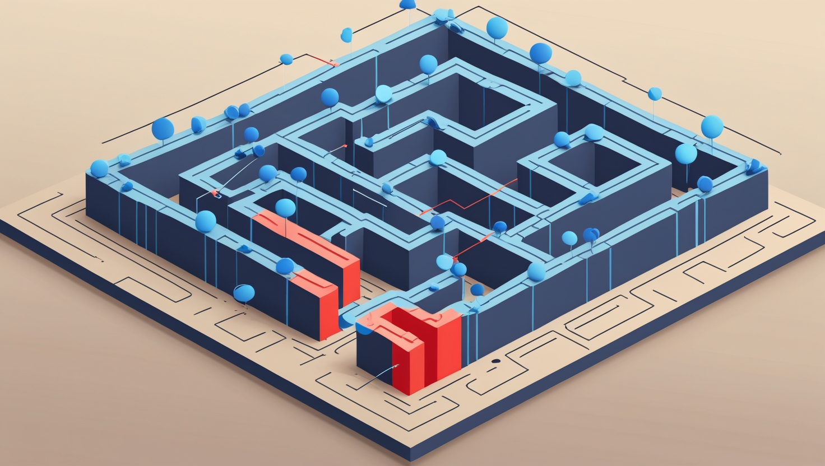
Demonstration
(LINK)

Slide 11

Reference
[1] SQLPad.io, "Python Maze Solver Tutorial," [Online]. Available: https://sqlpad.io/tutorial/python-maze-solver/. [Accessed: Apr. 03, 2025]
[2] Encyclopedia.pub, "Maze Solving Algorithm," [Online]. Available: https://encyclopedia.pub/entry/33079. [Accessed: Apr. 03, 2025]
[3] Level Up Coding, "A-star (A*) Search for Solving a Maze using Python (with Visualization)," [Online]. Available: https://levelup.gitconnected.com/a-star-a-search-for-solving-a-maze-using-python-with-visualization-b0cae1c3ba92. [Accessed: Apr. 03, 2025]

Slide 12
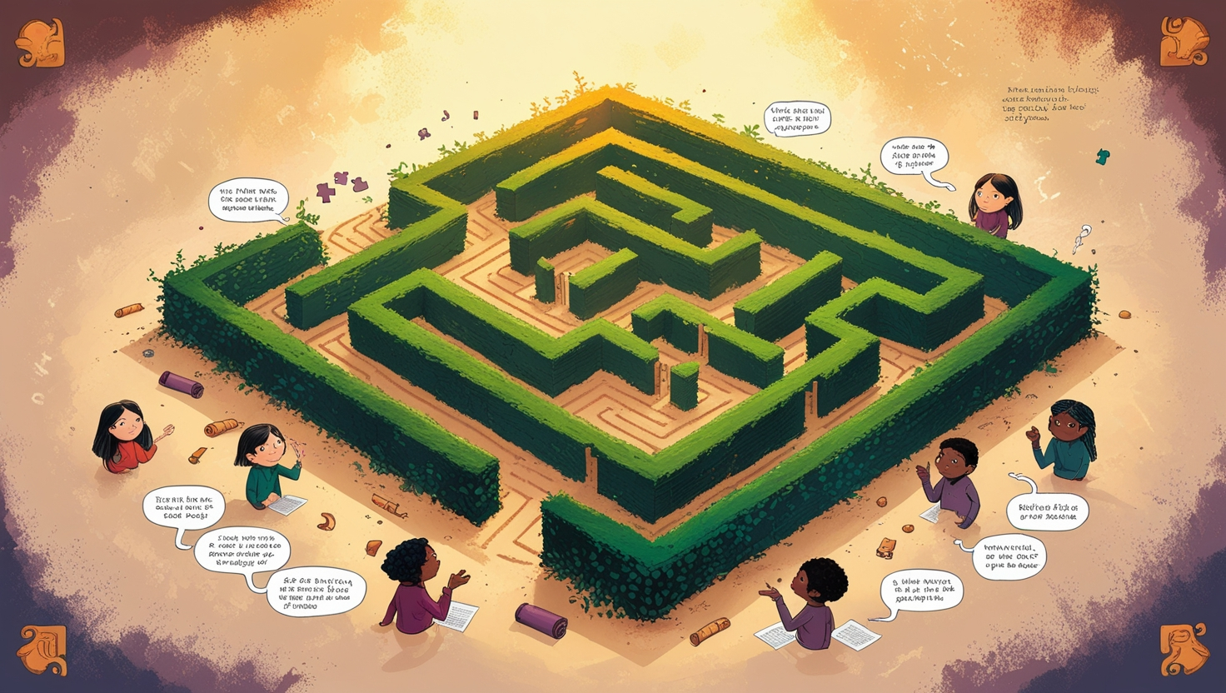
Q & A
THANK YOU!

